Slide 1

Smoking Cancer Detection Mobile Application

Slide 2


Team Members
Abdelrahman Yasser Mohamed
20-00184
Mohamed Ahmed Saeed
20-00312
Ahmed Hamada Hamdy
19-00764
Mohamed Mostafa Saad 20-00365
Mostafa Youssef Obaid Youssef 20-01130
Diana Ashraf Wadea 20-00047
Mohanad Nasser Abdelawal
18-00499

Slide 3
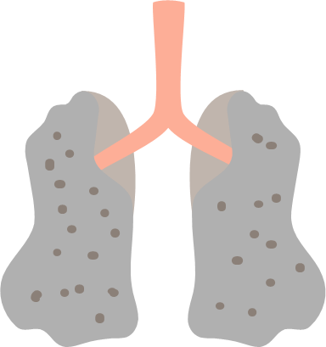

Agenda
Introduction
Motivation
Problem Statement
Objectives
Data Used
Methodology
Machine Learning
Model Accuracy
Application
future work
References

Slide 4
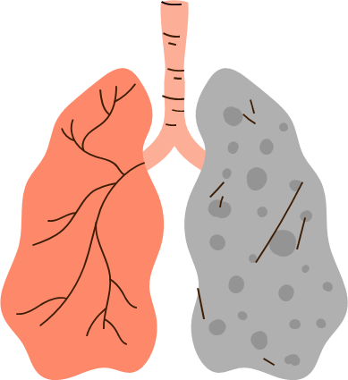
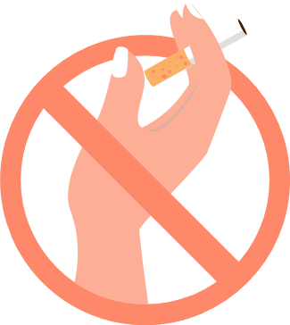


Introduction
Impact of Smoking on Health
Lung Cancer and Smoking
Cancer Linked to Smoking
Public Health Interventions

Slide 5
Motivation
The motivation behind our project stems from the need to address the alarming rise in smoking-related cancer cases.Rising health care costs

Slide 6
Problem Statement
Despite numerous awareness campaigns, many cases of smoking-related cancers are still diagnosed in later stages, leading to poor prognosis.
Limited access to healthcare facilities and lack of awareness contribute to delayed diagnosis.
here's a need for an easy-to-use, accessible tool for early detection that can reach individuals regardless of their geographical location.

Slide 7
Objectives
Early Detection and Intervention
User Education and Awareness
Behavioral Change Support
implement notifications and reminders for health check-ups and behavioral goals

Slide 8
Data Used
Lung and Colon Cancer Histopathological Images

Slide 9
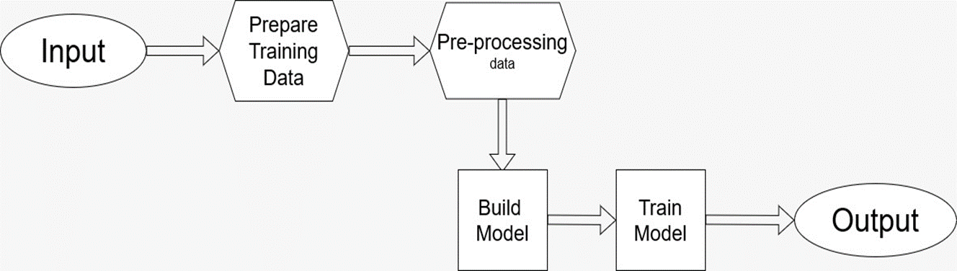
Methodology

Slide 10
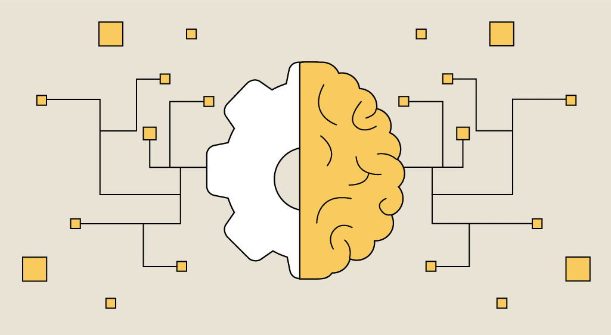
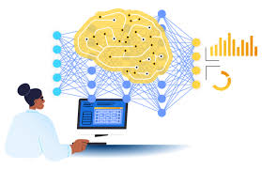
Machine Learning
Tensorflow
PyTorch

Slide 11
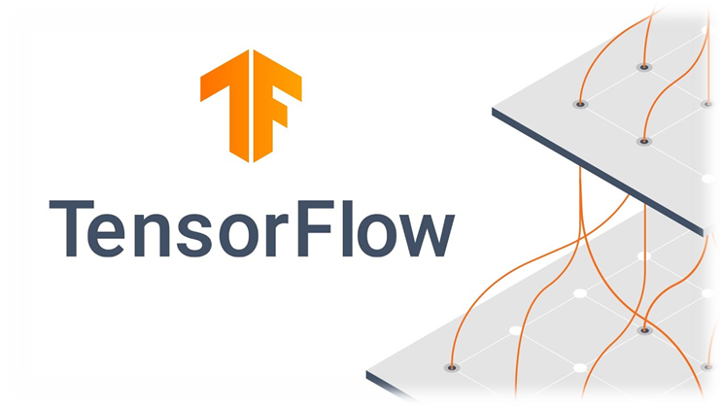

Tensorflow
Scalability
Flexibility
High Performance
Integration with Other Technologies
Continual Improvement
AutoML Capabilities

Slide 12
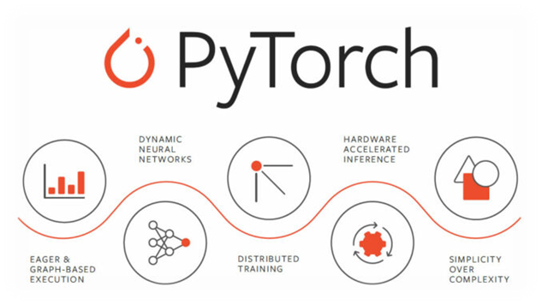
PyTorch
Dynamic Computational Graph
Easier to Learn and Use
Deployment Flexibility
Active Community and Development
Debugging and Profiling Tools
Pythonic Interface

Slide 13
Application
Flutter
Dart
Flask

Slide 14

We have used Flutter to design our mobile Application has numerous advantages over
its competitors. These advantages are inherent in the programming language and in the set of
Development tools that allow Flutter to solve issues that other languages cannot cope with
Flutter consists of two important parts:
An SDK (Software Development Kit): A collection of tools that are going to help you develop your applications. This includes tools to compile your code into native machine code (code for iOS and Android)
A Framework (UI Library based on widgets): A collection of reusable UI elements

Slide 15

- A powerful programming language developed by Google.
- Used for web and mobile Development.

Slide 16
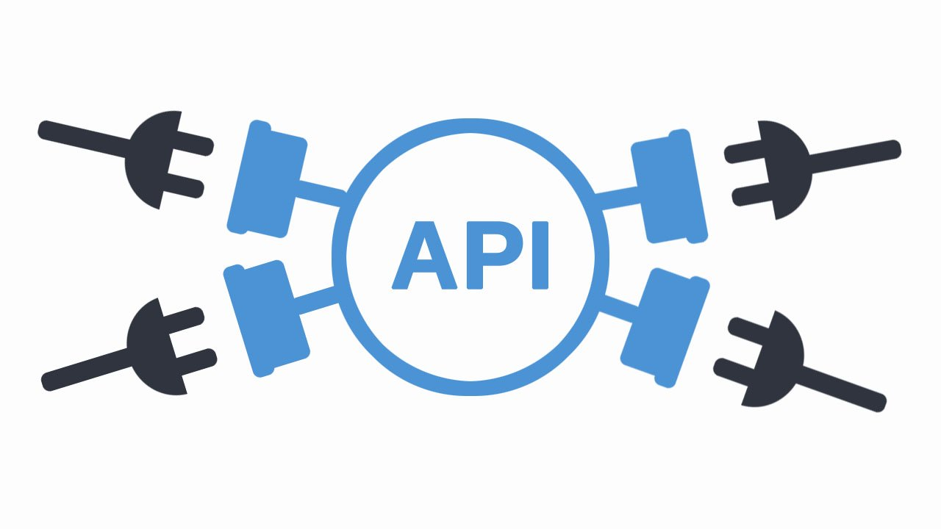
Flask is a lightweight and flexible Python web framework suitable for building APIs.
Its simplicity and ease of use make it ideal for our project's requirements.
Flask integrates seamlessly with TensorFlow and PyTorch, allowing us to deploy our machine learning models efficiently.

Slide 17
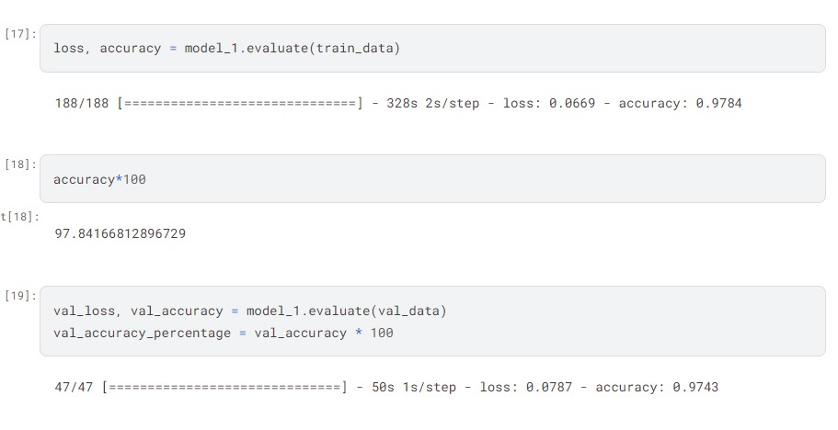
Model Accuracy

Slide 18
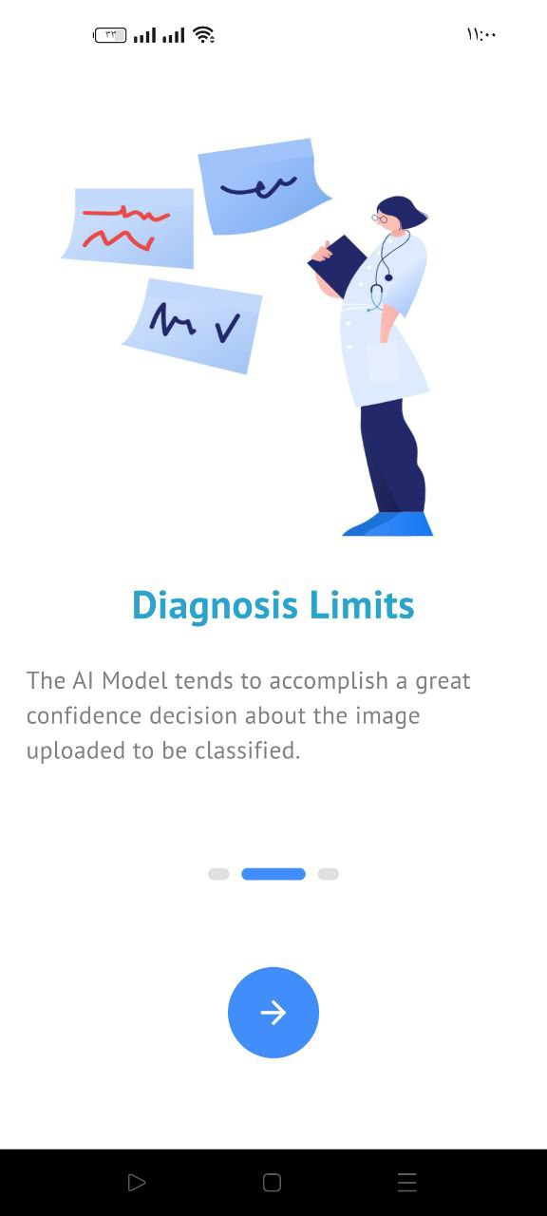
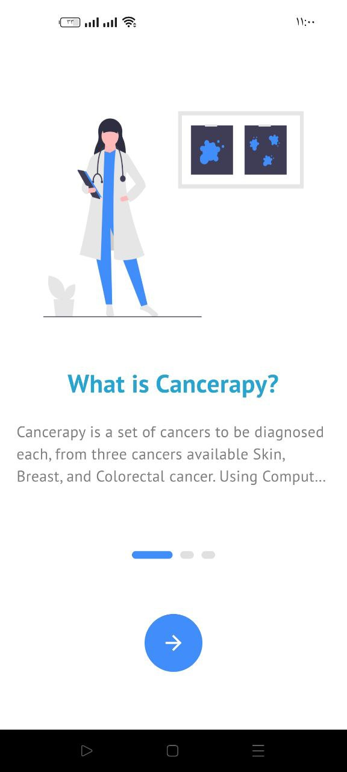
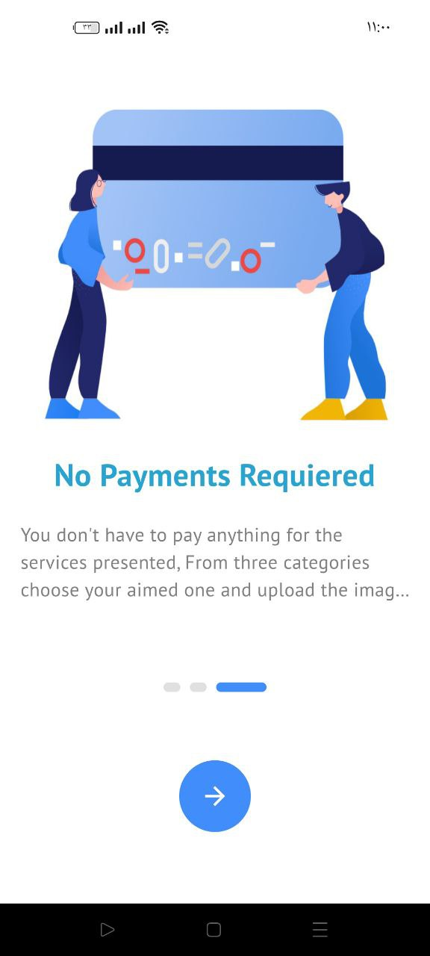

prototype

Slide 19
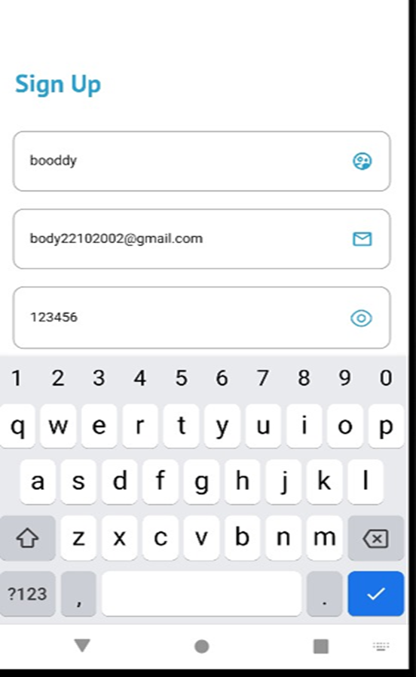
Sign up

Slide 20
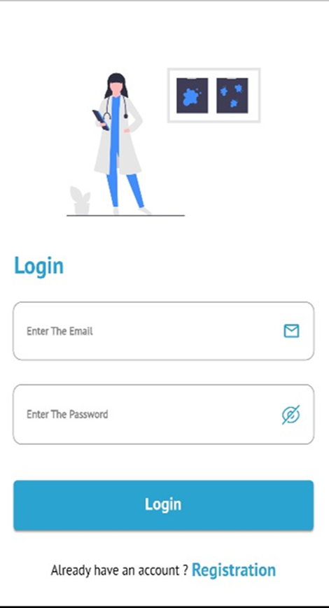
Login

Slide 21
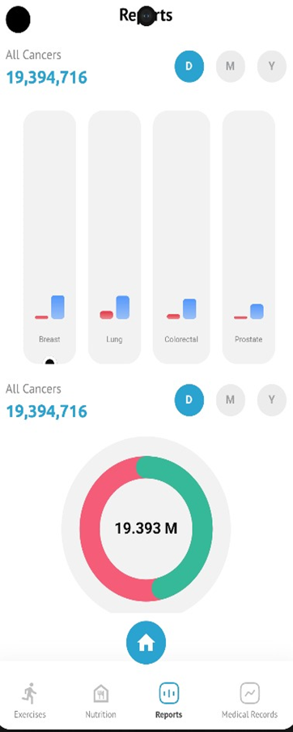
Report Page

Slide 22
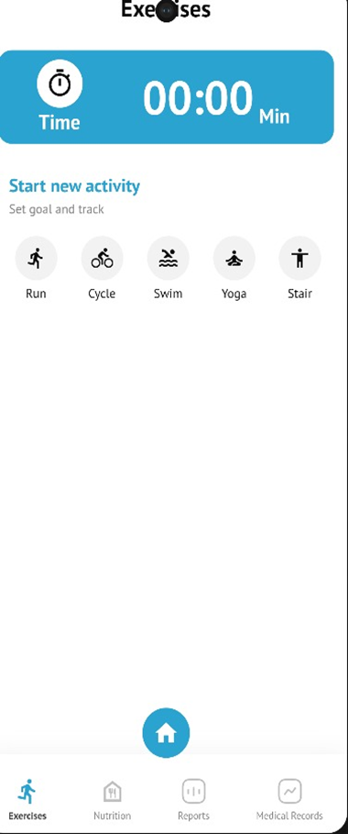
Execises page

Slide 23
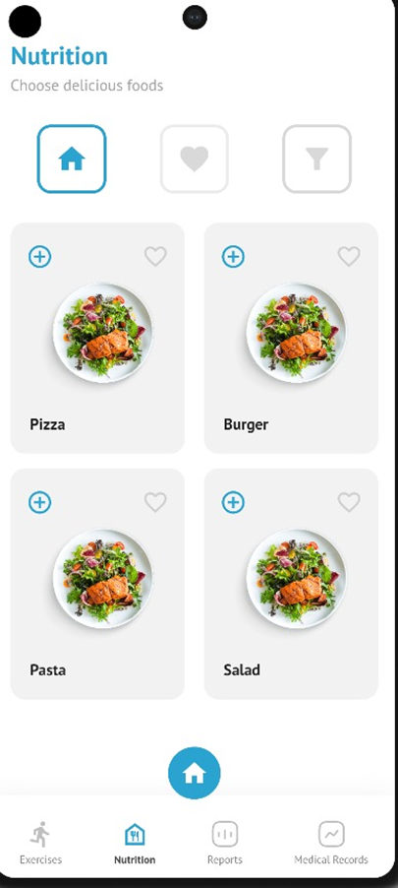
Nutrition page

Slide 24
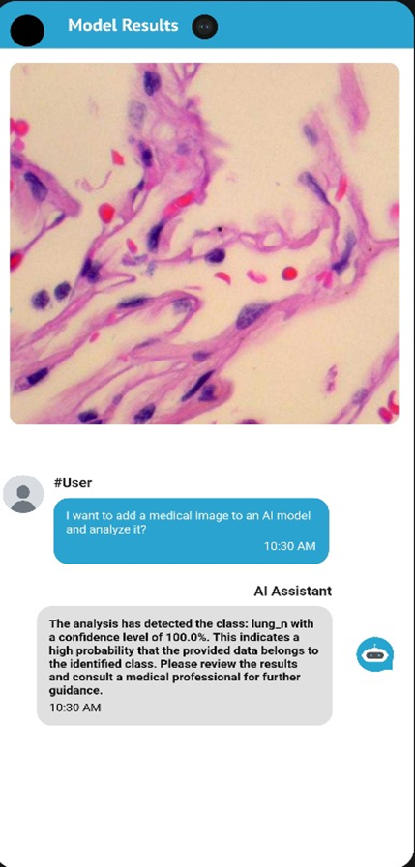
Let’s Diagnosis your Image

Slide 25
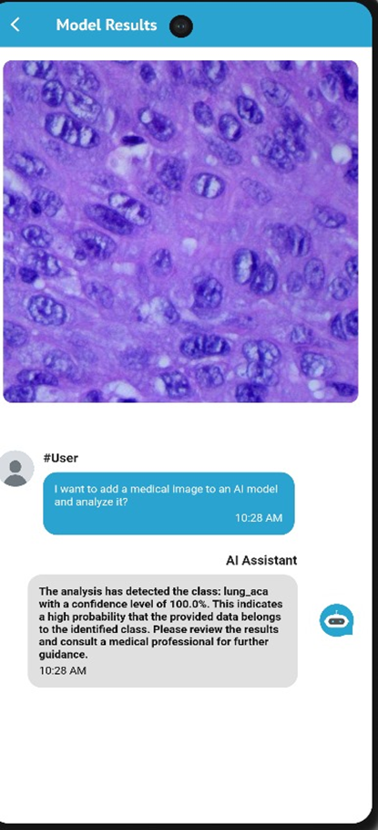
Lung cancer page

Slide 26
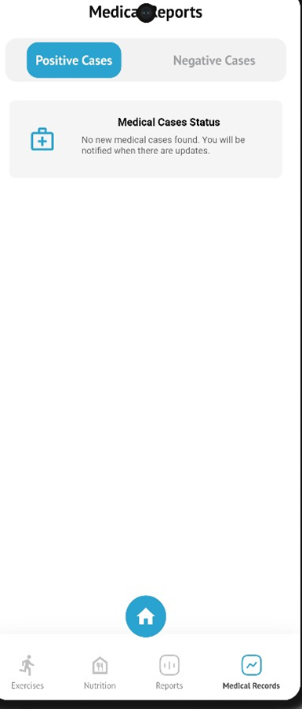
Medical Records page

Slide 27
Future Work
Continuous improvement and refinement of the application based on user feedback and technological advancements.
Integration of additional features such as teleconsultation with healthcare professionals and personalized risk assessment.
Expansion of the application to cover a broader range of cancer types and risk factors.
Collaboration with healthcare organizations and regulatory bodies to ensure compliance and ethical use of the application.

Slide 28
References
https://flutter.dev/
GitHub: Let’s build from here · GitHub
Health Risks of Smoking Tobacco | American Cancer Society
Health Effects of Cigarettes: Cancer | Smoking and Tobacco Use | CDC

Slide 29
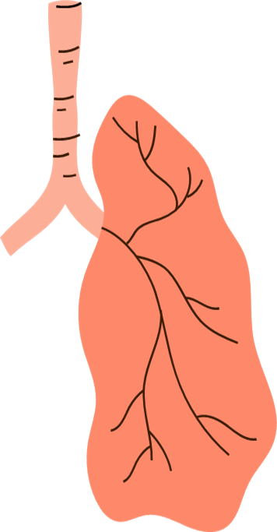
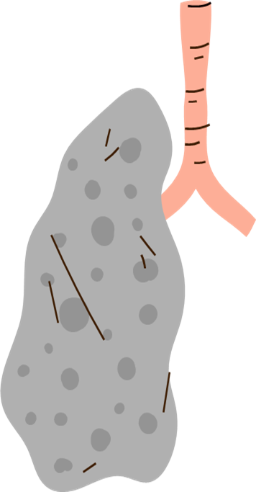

Thanks

